Slide 1
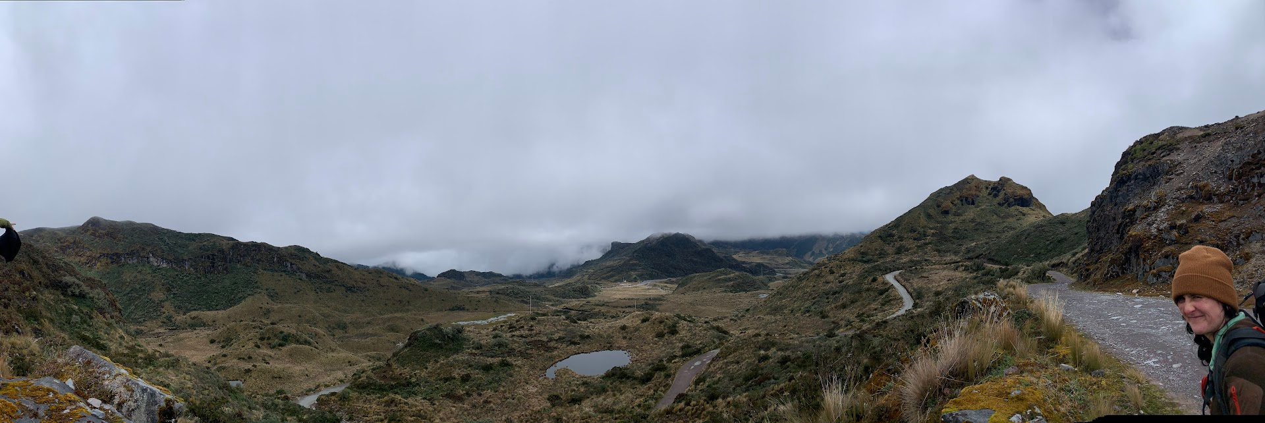
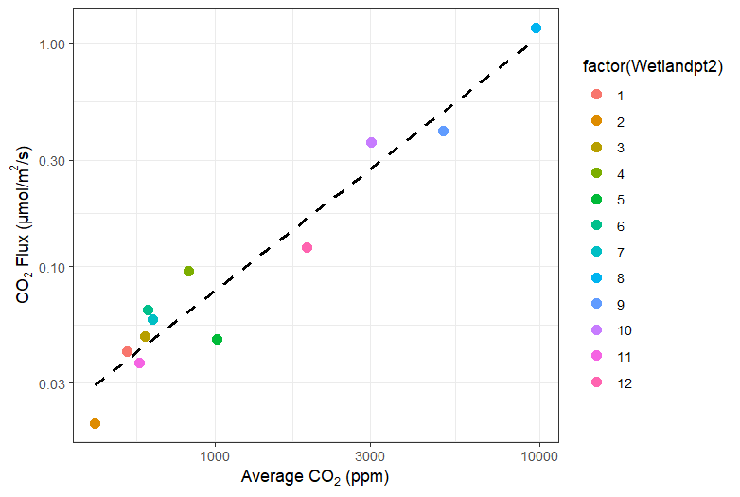
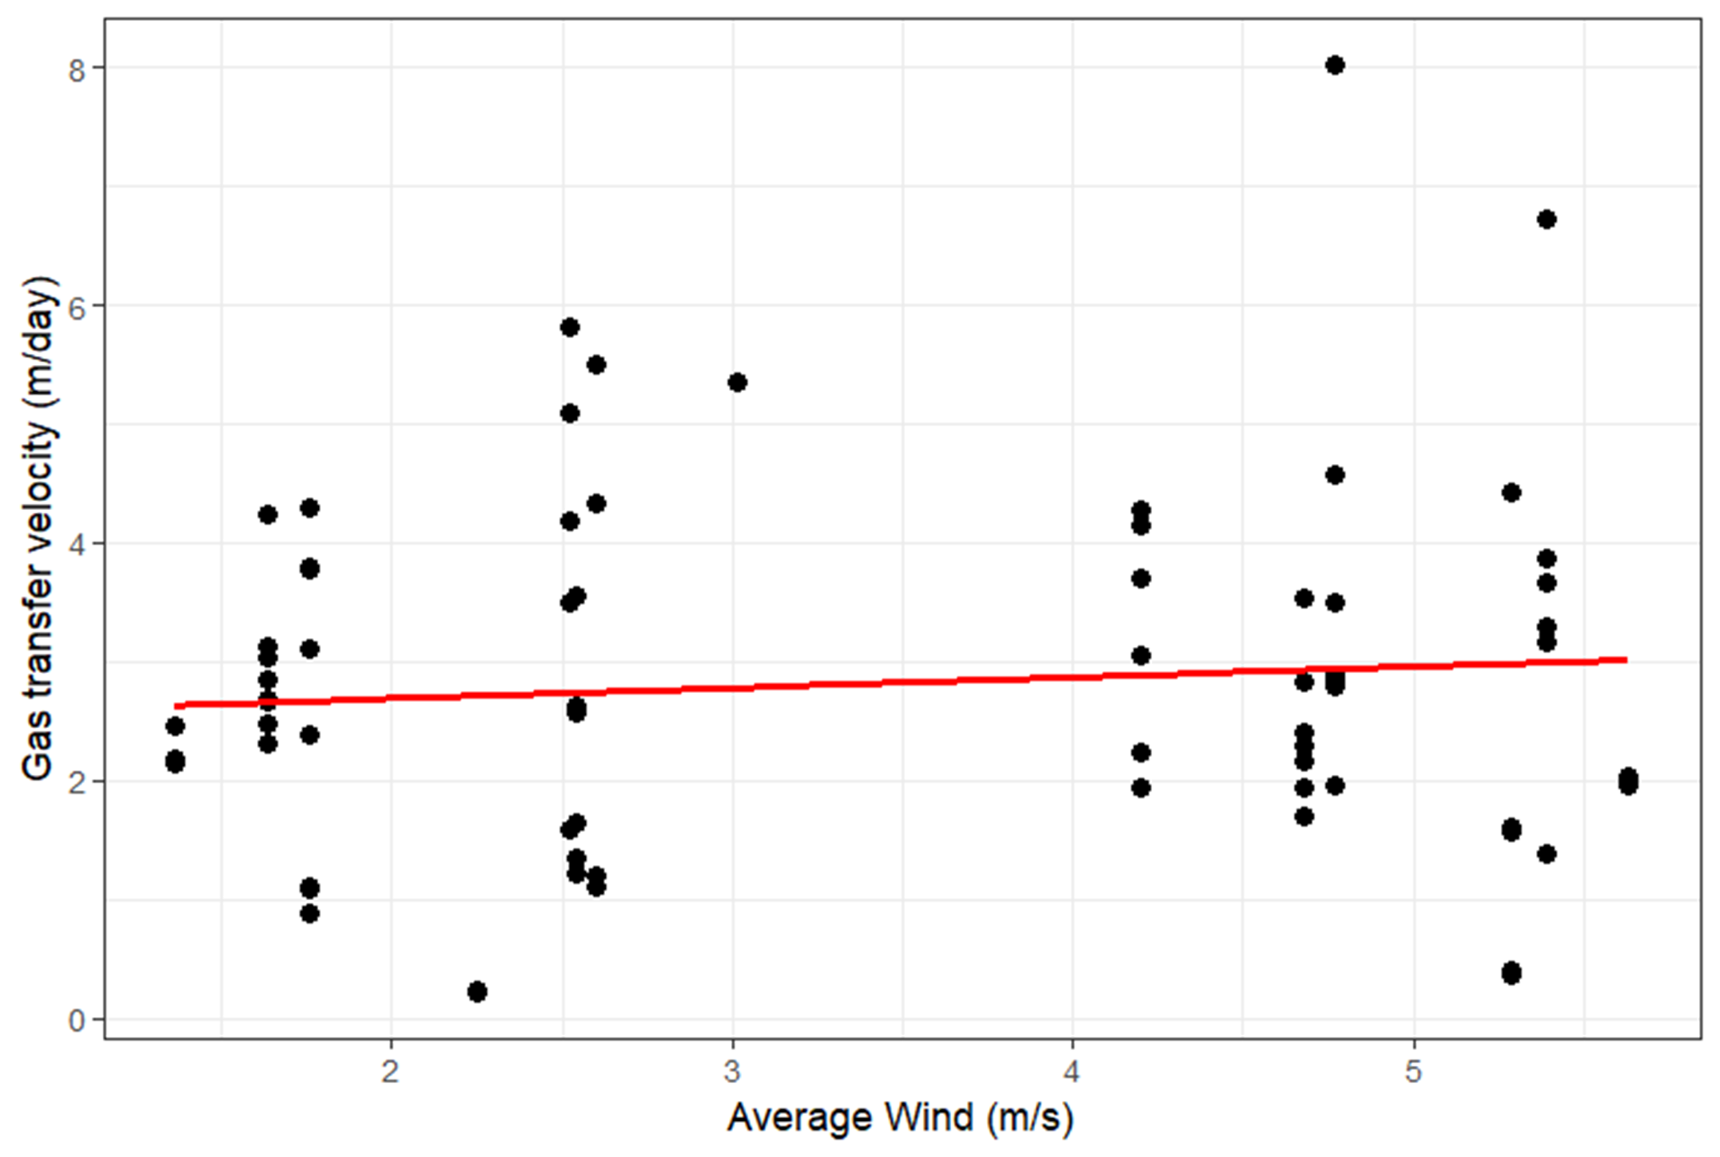
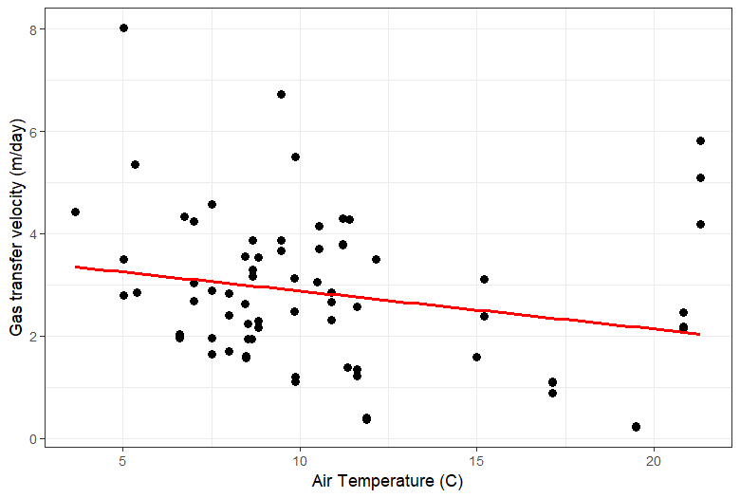
Multifaceted Influences on Carbon Dioxide Flux in Freshwater Wetlands
Amy Madrigal, Dani Zarate, Kayla Emerson, Keridwen Whitmore, and Diego Riveros-Iregui
University of North Carolina at Chapel Hill
Introduction
Results
Figure 5.
Field site in Cayambe-Coca national park.
• Wetlands occupy approximately 4-6% of the Earth’s land area, and act as carbon sinks storing approximately 25-30% of the world's terrestrial carbon while also contributing to carbon emissions (2).
•Currently, there has been a dearth of research on the specific factors that contribute to CO2_flux.
• The study aims to assess if particular mechanisms significantly impact CO2_flux in freshwater wetlands.
• In this study, CO2_flux was measured as the movement between CO2 and the atmosphere (4).
• Gas transfer velocity (k) was measured by the rate of gas exchange between air and water interfaces(4).
Field site
• Field sampling was completed at 12 wetlands from June to July 2022 in Cayambe-Coca National Park, located in Ecuador. (Figure 1)
• Sample collection took place in the paramos in Ecuador. The paramos can only be found in the Andes mountains at an altitude above 12,500 feet. It has the highest botanical biodiversity of all high-altitude systems (1).
• Paramos function as natural sponges, collecting water from precipitation and melting mountain tops and gradually releasing it to the lowlands (2).
Wind speed and k have a positive linear relationship; however, the relationship is not statistically significant.
Air temperature and k have a negative linear relationship, and the relationship is statistically significant.
CO2 flux=-0.0383787+(.0001172*average CO2)
P-value: 7.157e-09
Figure 2. Average wetland CO2 vs CO2_flux.
Each data point on the graph represents the calculated averages of the individual wetlands.
The average CO2_flux for each wetland was computed by taking the mean of all of the CO₂_flux measurements obtained during the three-days of testing. The average CO2 for each wetland was computed by taking the mean of all of the CO2 levels measured during the three-day testing period.
Conclusion and future direction
Conclusion
•CO2 and CO2_flux contained the strongest positive correlation relationship, which revealed that the wetlands that were being examined had a consistent transfer velocity of CO2 across the different wetlands.
•There is a statistically significant relationship between the air temperature and k. This suggests that air temperature is an important mechanism for CO2_flux.
•The relationship between the average wind and the k is not significant, indicating that wind speed is not a strong mechanism that affects CO2_flux.
Future direction
• Identifying mechanisms affecting carbon storage in freshwater wetlands.
• Broaden wetland analysis to uncover more CO2_flux influences.
Acknowledgment
This work was supported by the National Science Foundation (EAR‐1847331). We would like to thank the staff at the University of San Francisco Quito (USFQ) for logistical support as well as the communities of Cumbayá and Quito, Ecuador. We thank the Ministry of the Environment of Ecuador (research permit 014‐018‐IC‐FLO‐ DPAN/MA) and the National System of Protected Areas of Ecuador for site access.
k=-2.61323+(0.03476 *average wind)
p-value: 0.782
Figure 3. Average wetland wind speed vs gas transfer velocity (k).
The average wind speed (meters per second) was the daily average collected from the weather station and was not specific to each wetland; it served as the measurements for the region as a whole. k, measured in meters per day, was collected from each wetland during the three testing dates. Three data points were collected each day.
Methods
•Gas sampling for the pCO2 and CO2_flux were collected from each of the 12 wetlands over a three-day period. An eosFD was used to collect CO2_flux, and a vaisala GMP252 was utilized to collect CO2 data. The devices were placed in three locations of each wetland for at least 15 minutes for more accurate readings.
• Wind speed data was collected from La Virgen Papallacta, a hydroclimatic weather station located in the national park.
•Linear models in R were utilized to visually analyze the relationships between mechanisms and CO2_flux in the wetlands.
• Gas transfer velocity was used as a comparative measure to evaluate the mechanisms' effects on CO2_flux. k is a crucial variable used to determine the flux of CO2, allowing insight into the impact of the mechanisms on CO2 dynamics.
k = 3.59302-(.07907*Air temperature)
p-value: 0.0389
Figure 4. Average wetland air temperature vs gas transfer velocity (k).
The air temperature was collected from each wetland on the three testing days, and measured in Celsius. k, measured in meters per day, was collected from each wetland during the three testing dates. Three data points were collected each day.
References
1) Lozano, Carlos. “What Are the Páramos and What Can You Do to Protect Them?” Interamerican Association for Environmental Defense (AIDA), 11 Apr. 2018, aida-americas.org/en/blog/what-are-p%C3%A1ramos-and-what-can-you-do-protect-them.
2) Shark, MikeOh. “This Unique Andean Ecosystem Is Warming Almost as Fast as the Arctic.” State of the Planet, 18 Nov. 2018, news.climate.columbia.edu/2018/11/15/paramos-ecosystem-climate-change/.
3) Watson, Robert T. Land Use, Land-Use Change, and Forestry. Special Report of the Intergovernmental Panel on Climate Change (IPCC). Cambridge University Press, 2000.
4) Whitmore, Keridwen. “Greenhouse Gas Emissions from the Freshwater Landscape in a High-Altitude, Tropical Ecosystem.” University of North Carolina at Chapel Hill, 2023.
Figure 1.
The yellow pin indicates the location of the field site in South America.

